Slide 1
So, You Think You Want To Travel?
Co-Sponsors:
Honors College Service Club and Engineers Without Borders
Campbell Hall
Michigan State University
Glenn Detrick
April 8, 2026

Slide 2
The Message of This Presentation:
Be Intentional
About travel and all aspects
of your life

Slide 3
MSU Global Focus Photo Competitions
Alumni Division
Winner: People’s Choice Awards
  2009 Carrot Top, Burkina Faso
  2010 Kid with Cat, Tibet
  2011 Pre-Dawn on the Ganges, Varanasi, India
  2022 Himalayan Hillside, Nepal
  2024 Study Time, Burma
  Every Picture Has A Story – And Memories

Slide 4
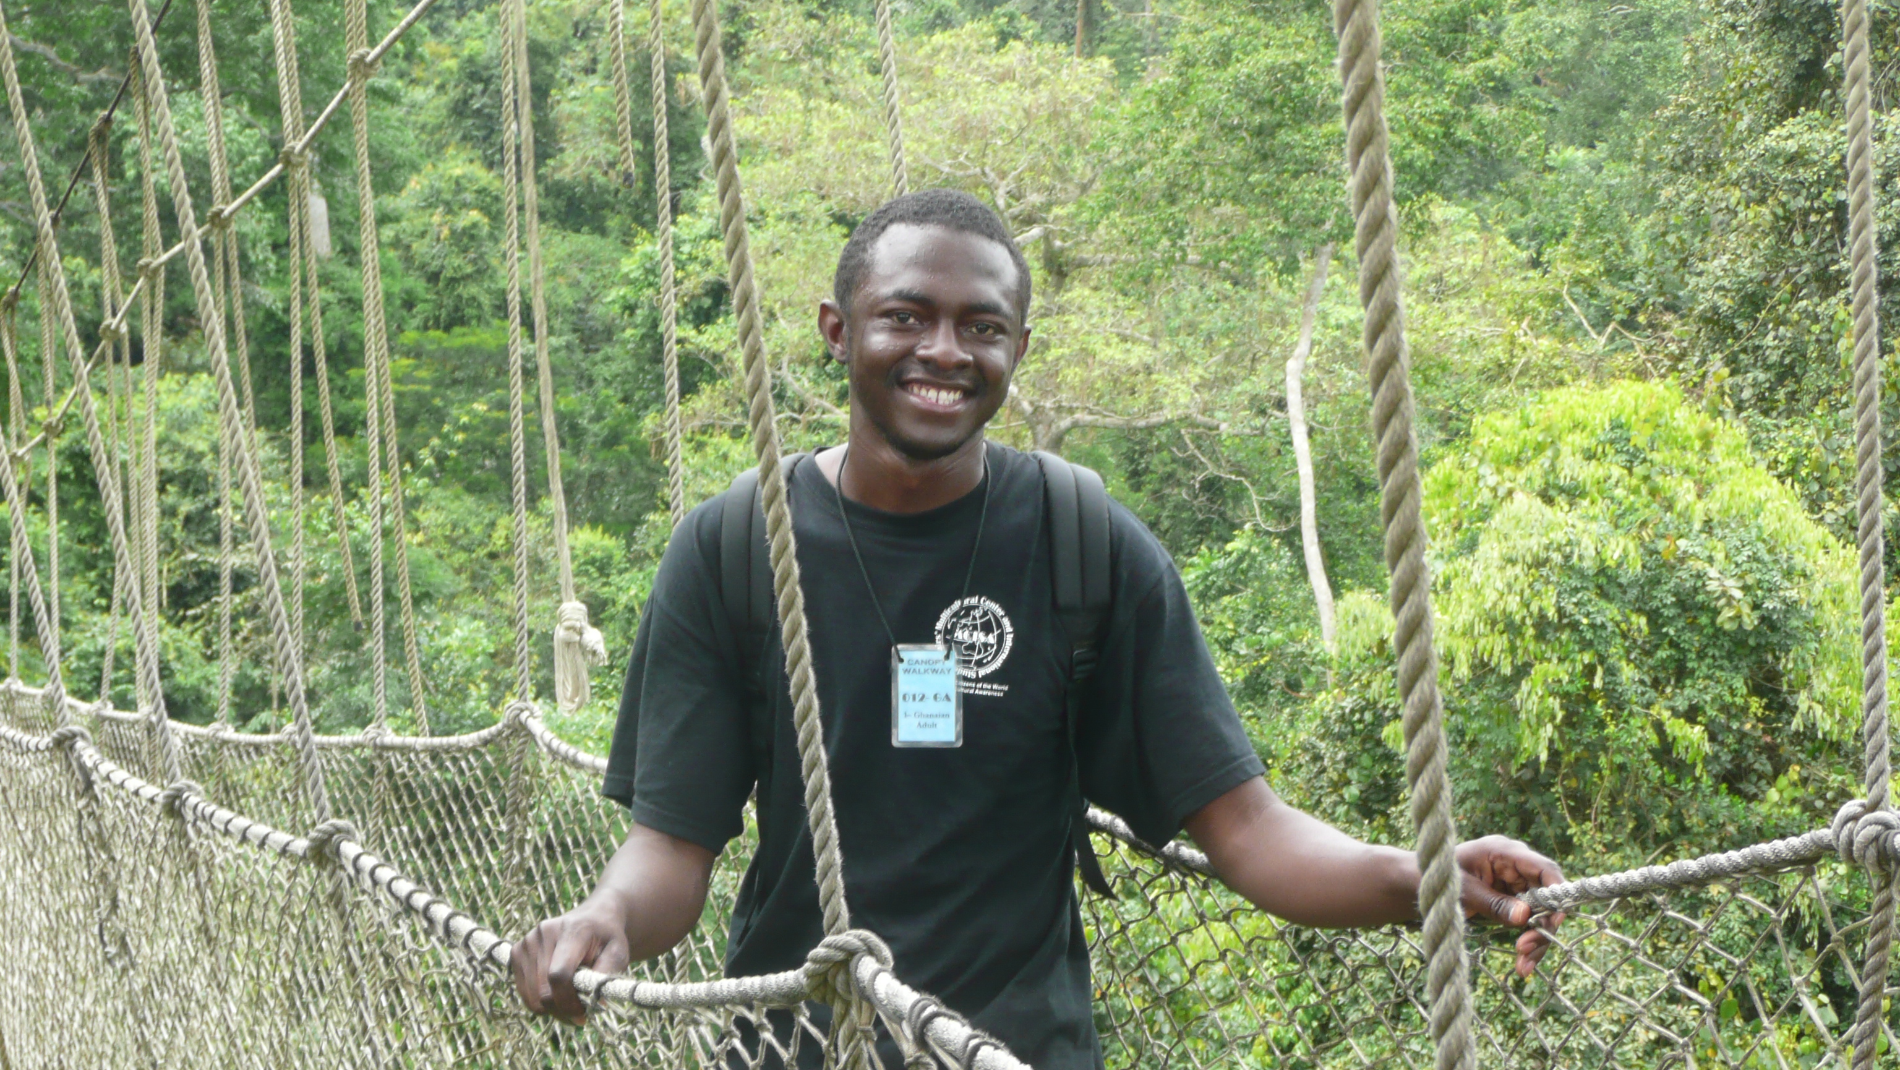
Abdoulaye
My ‘African Son’, from Burkina Faso

Slide 5

Carrot Top, Burkina Faso

Slide 6
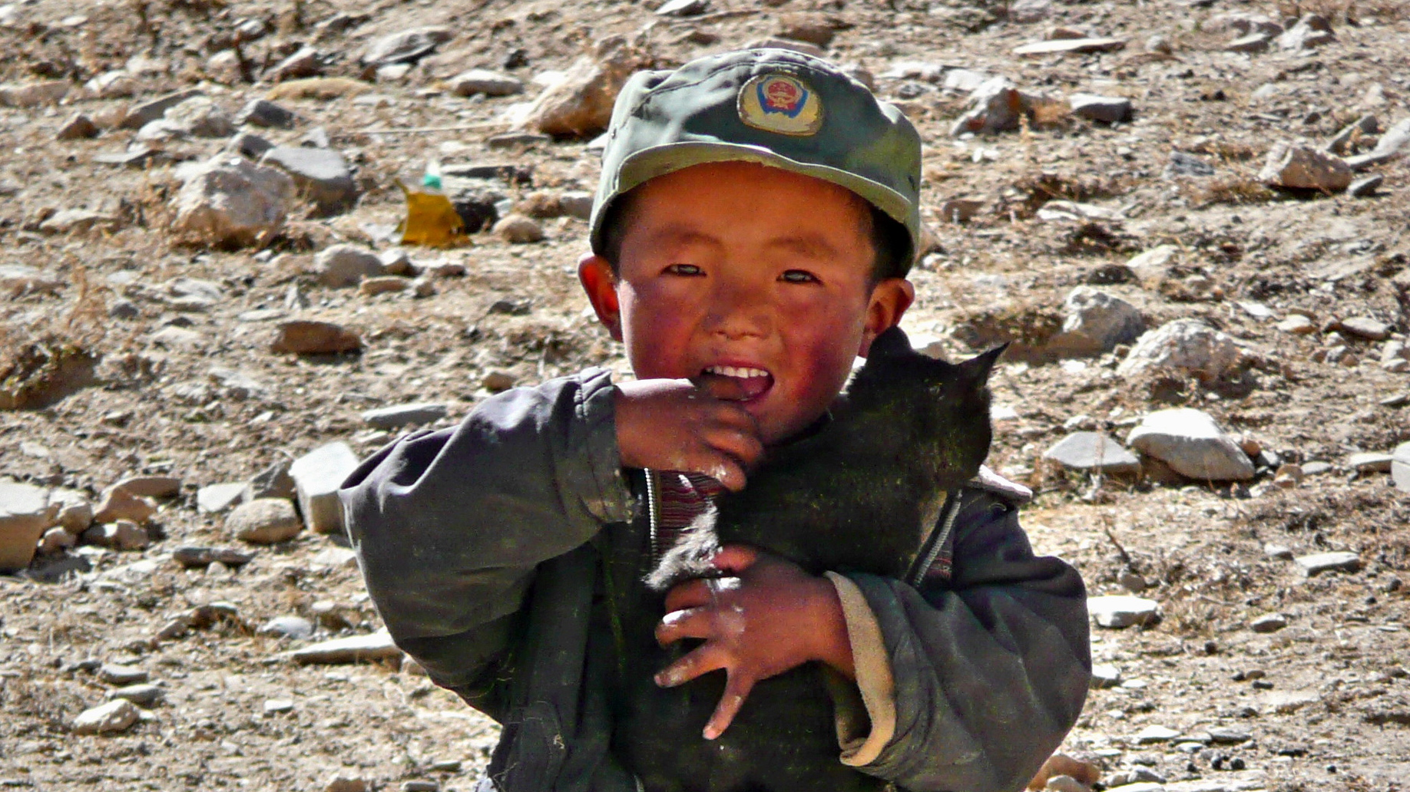
Kid With Cat, Tibet

Slide 7
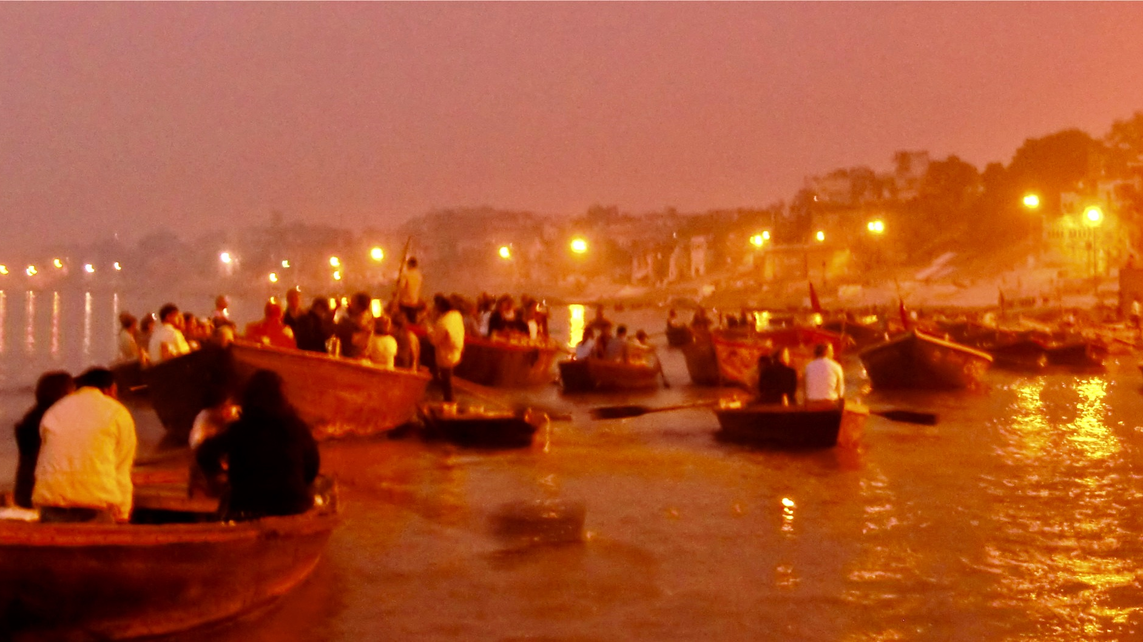
Pre-Dawn On the Ganges
Varanasi, India

Slide 8

Himalayan Hillside, Nepal

Slide 9
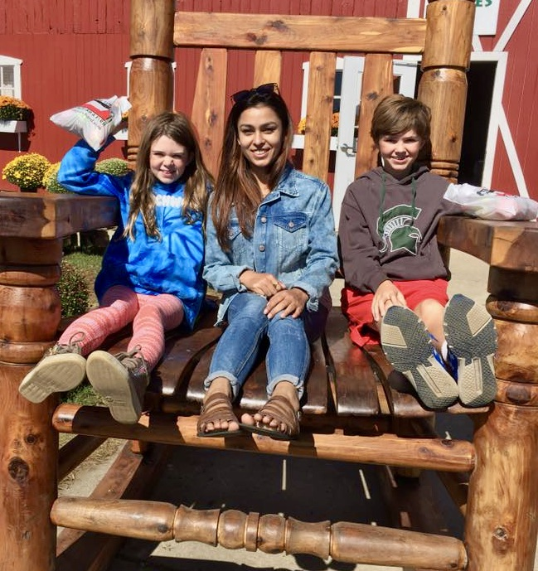
Priyanka and Future Spartans
Lucy Kelley My ‘Nepali Daughter’ Nick Kelley

Slide 10
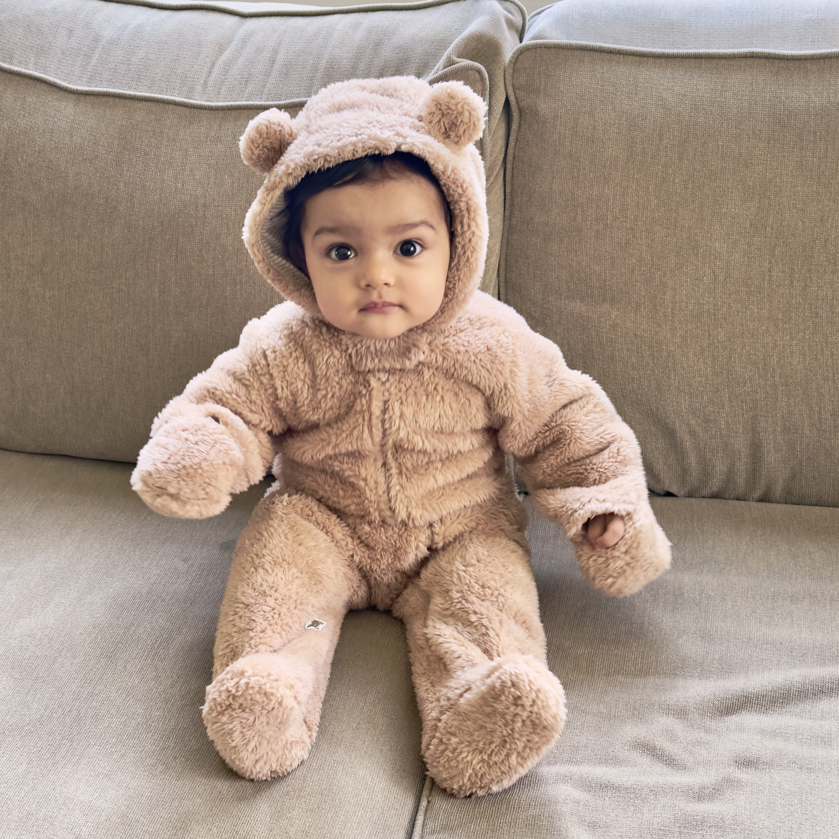
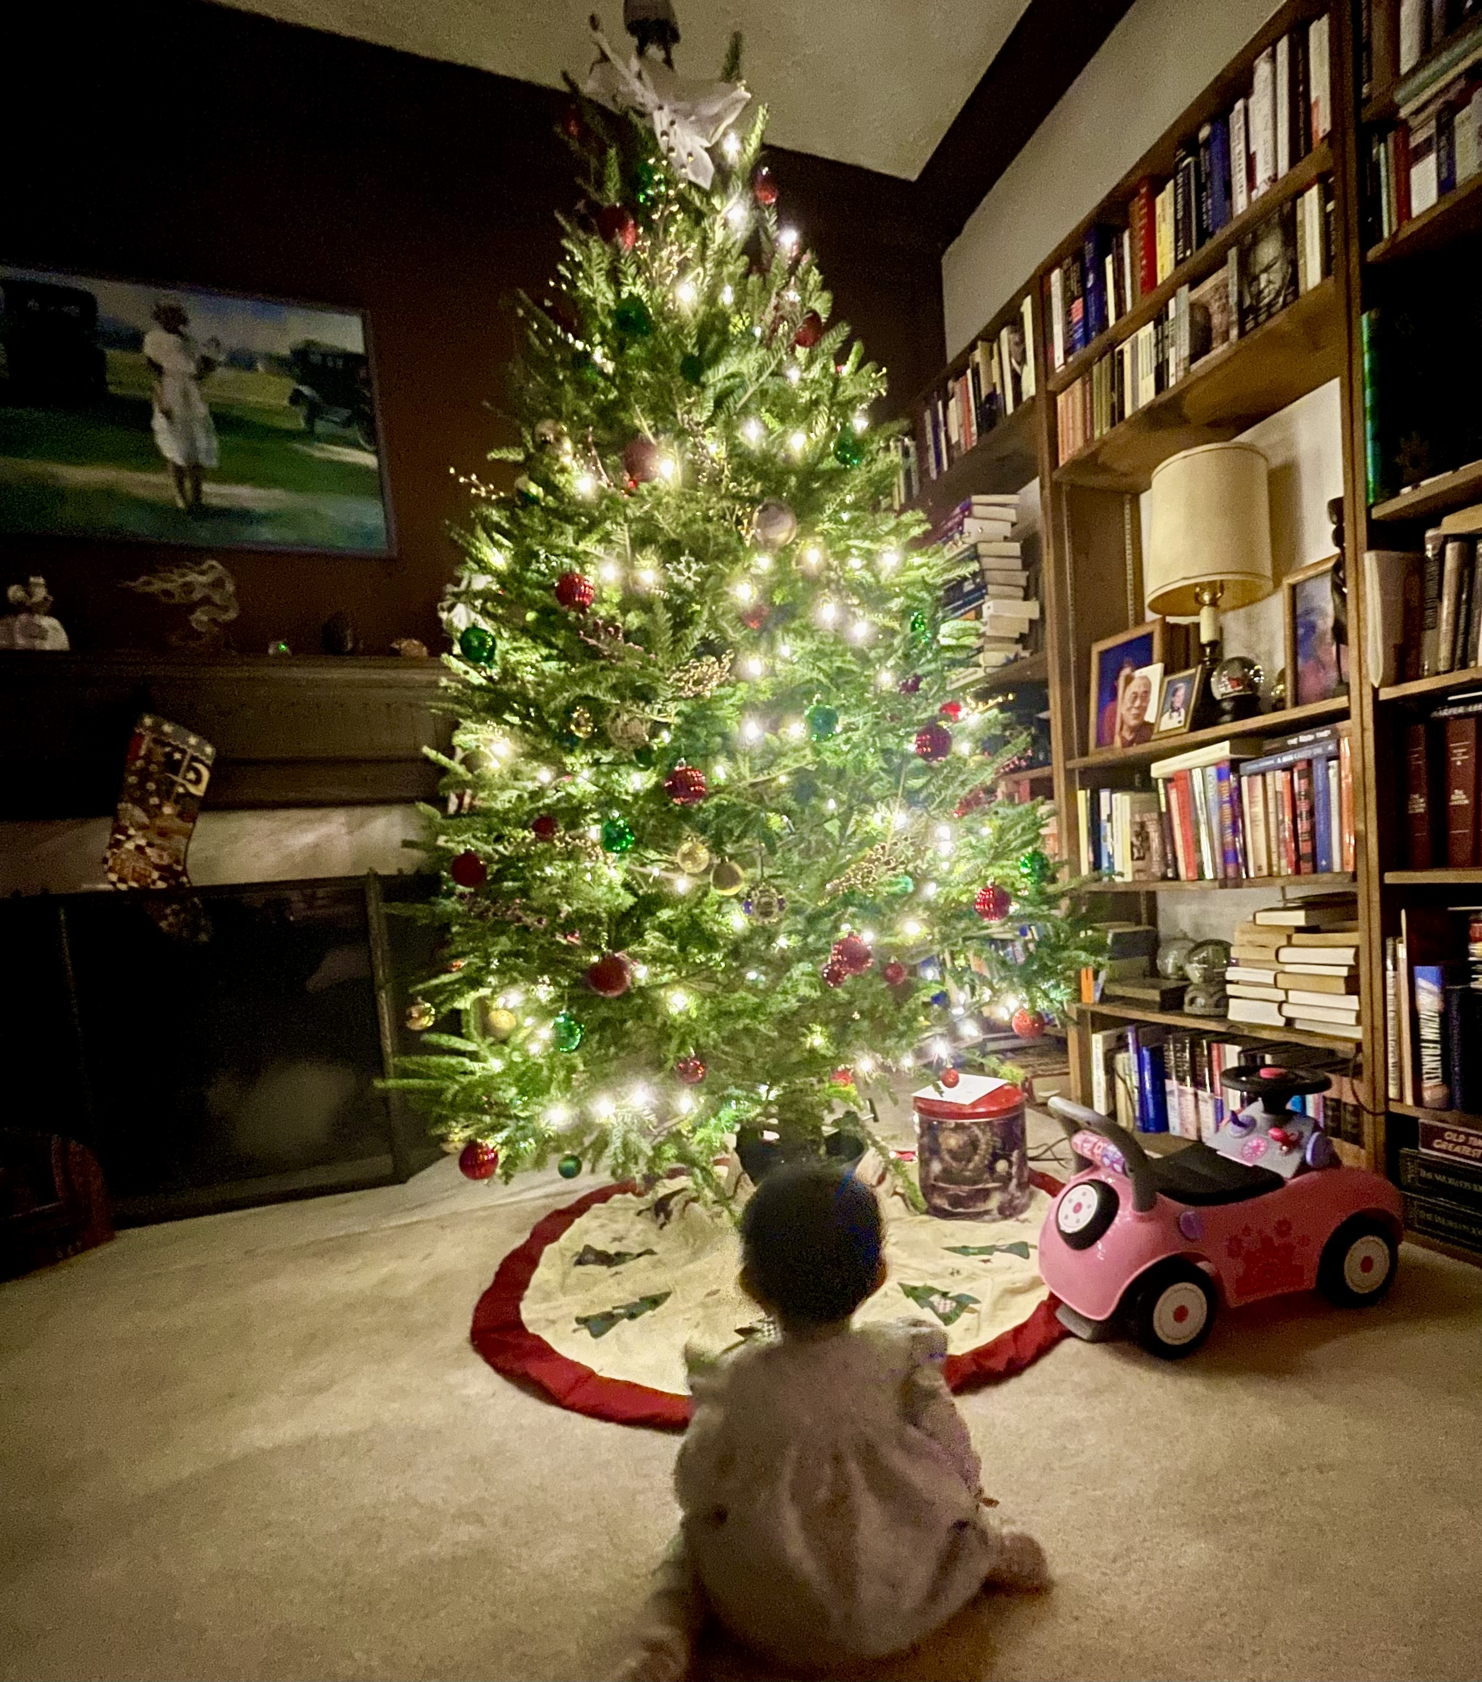
Priyanka’s Daughter Jun Chelsea
First Christmas

Slide 11
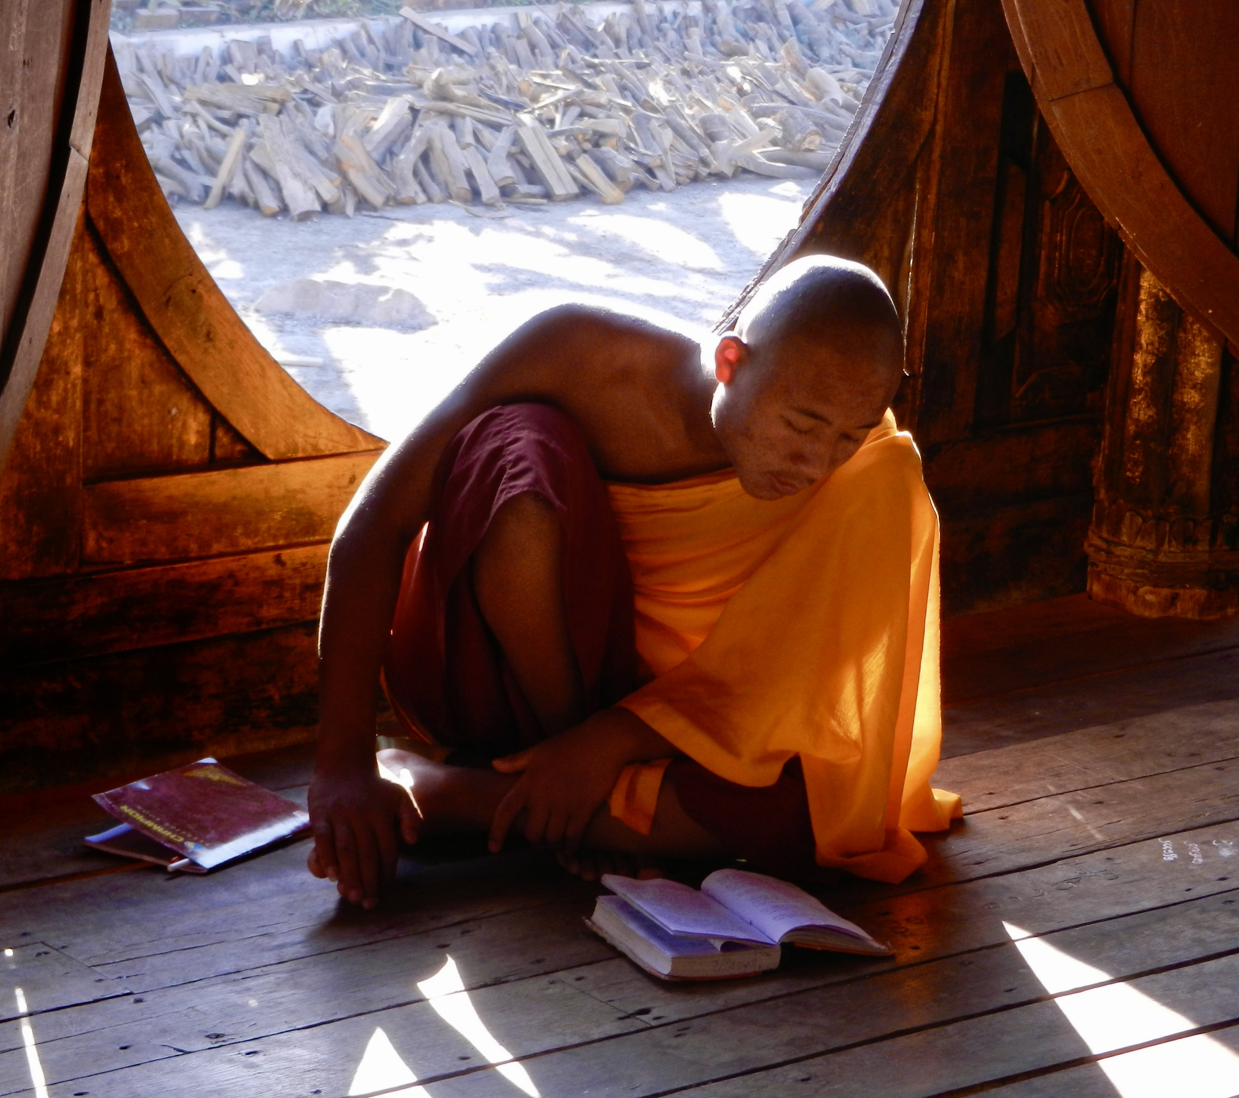
Study Time, Burma

Slide 12
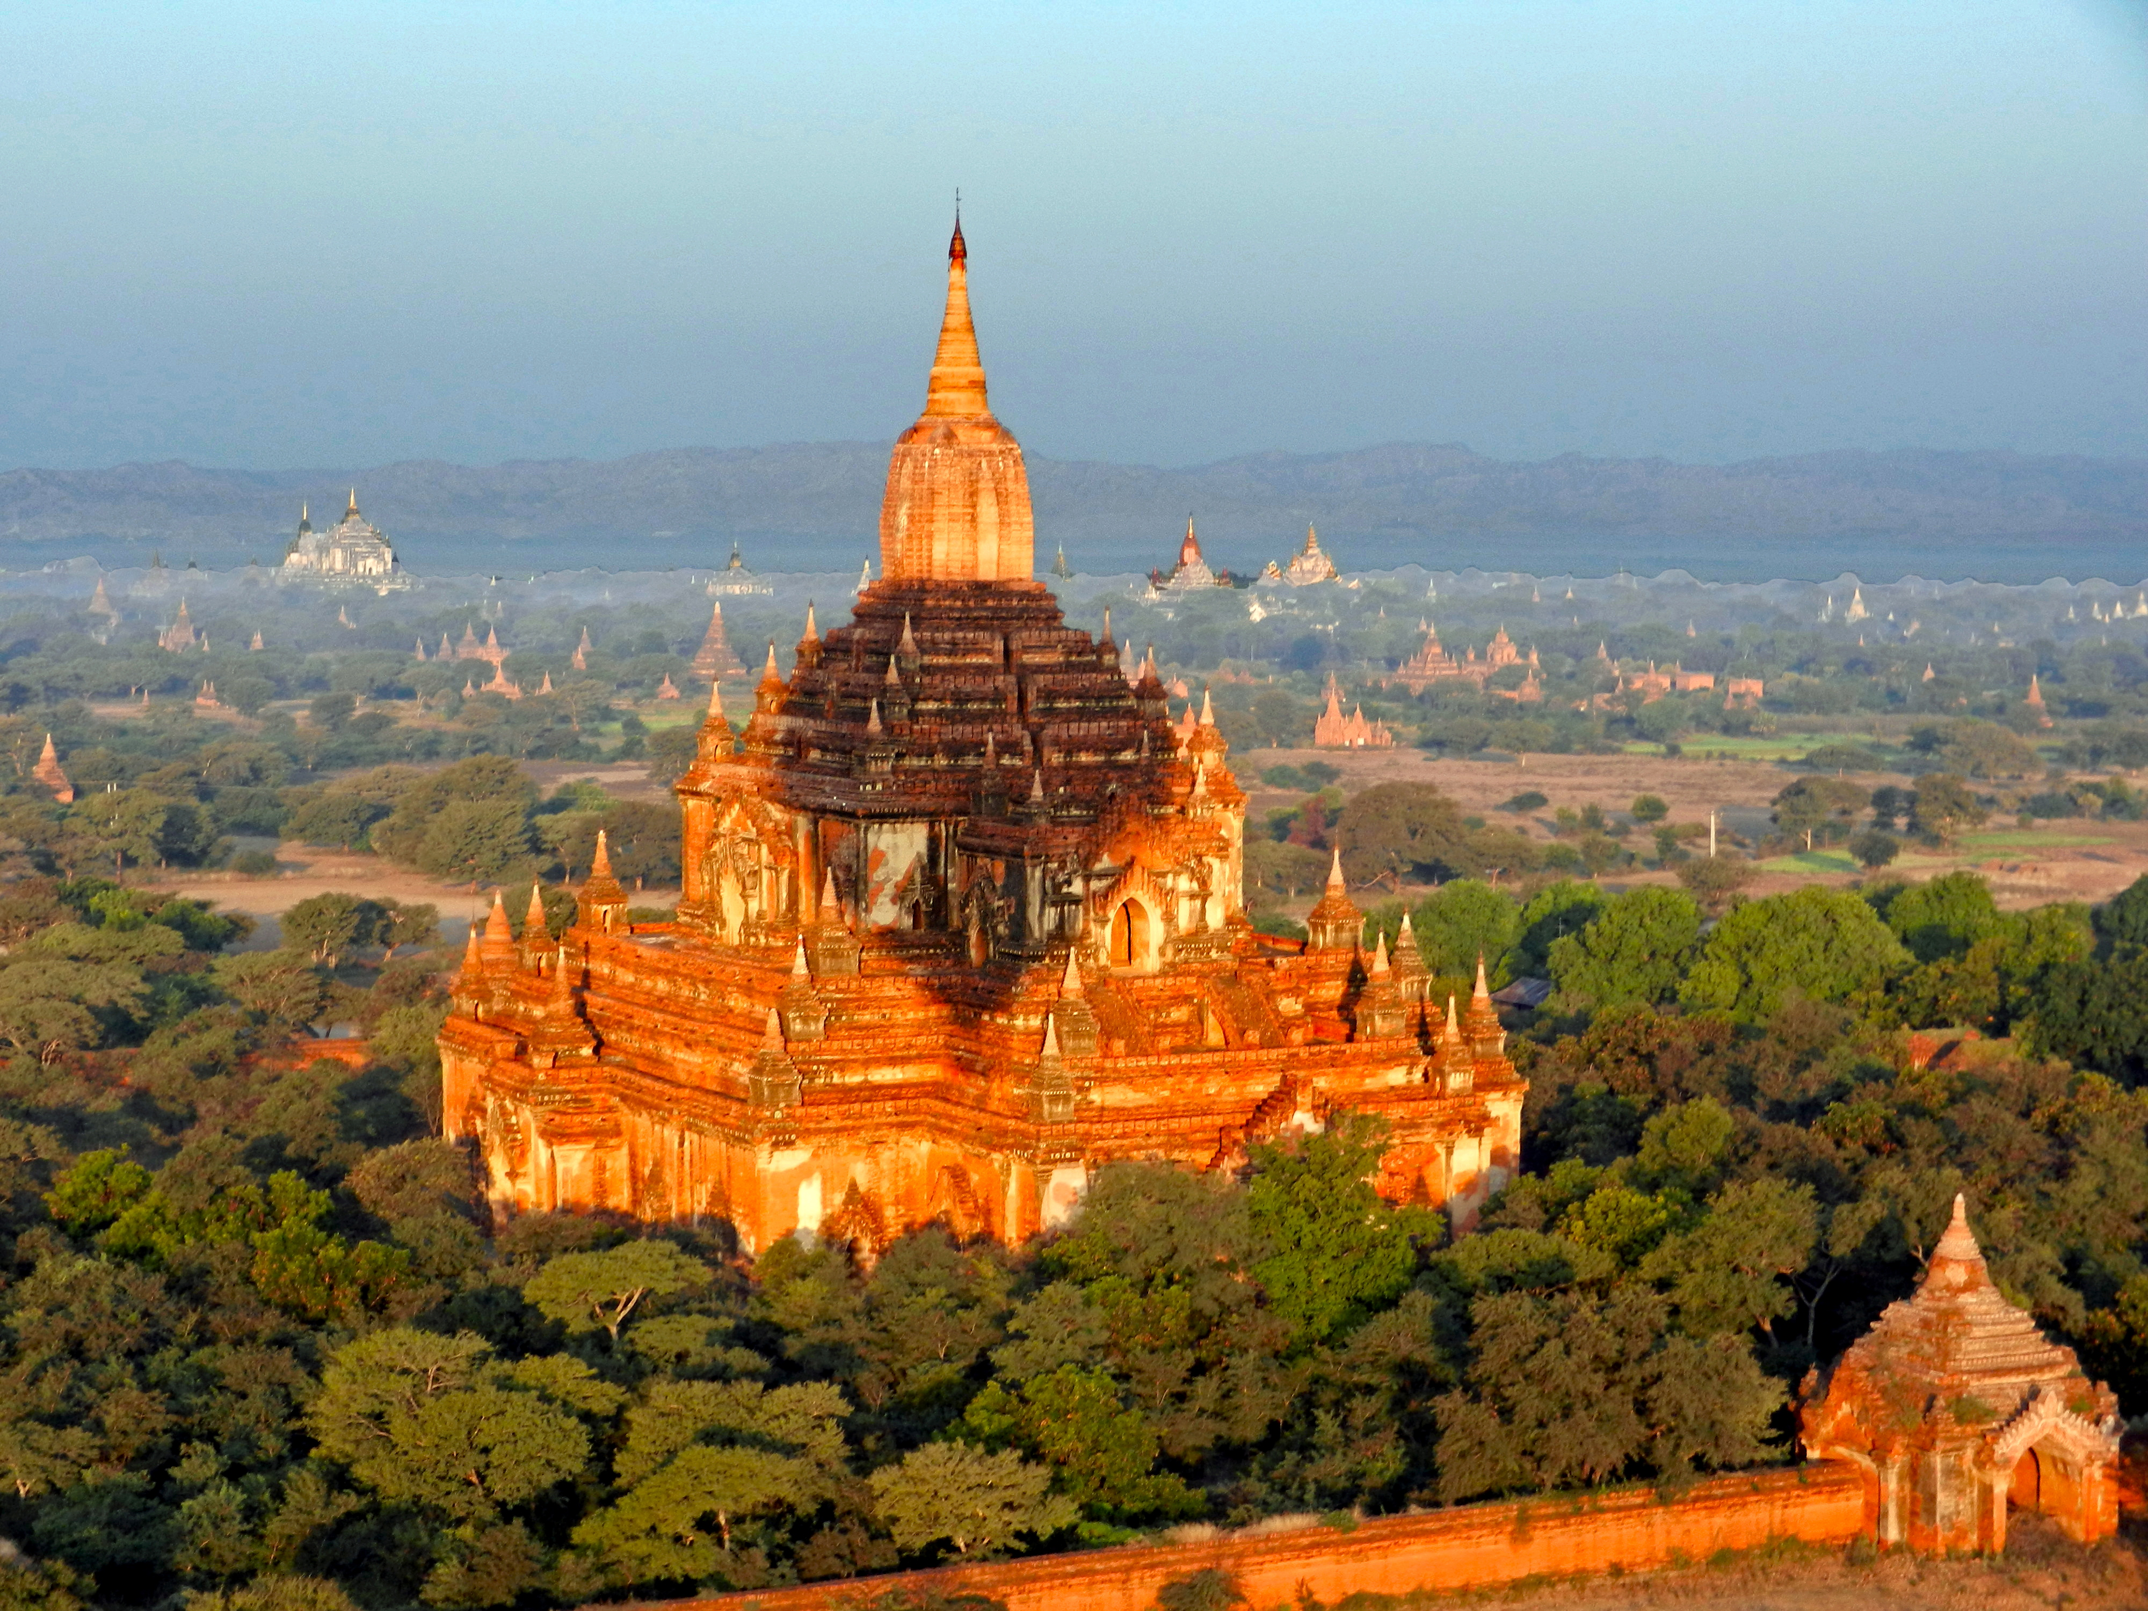
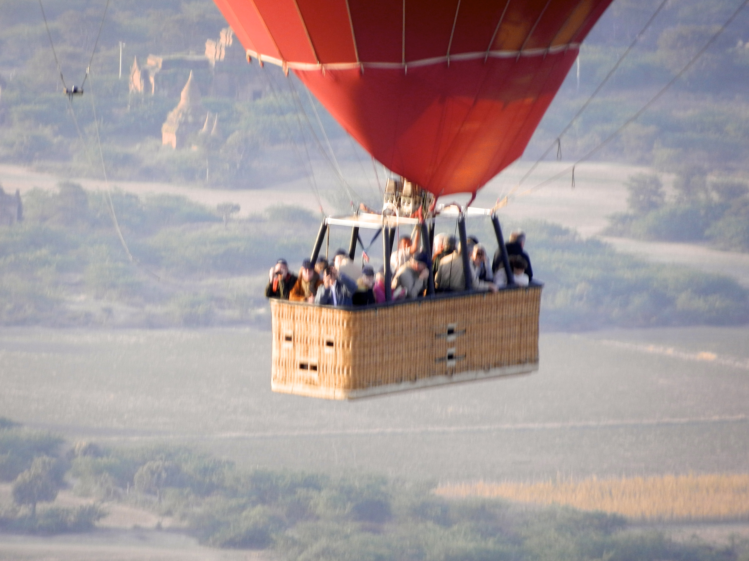
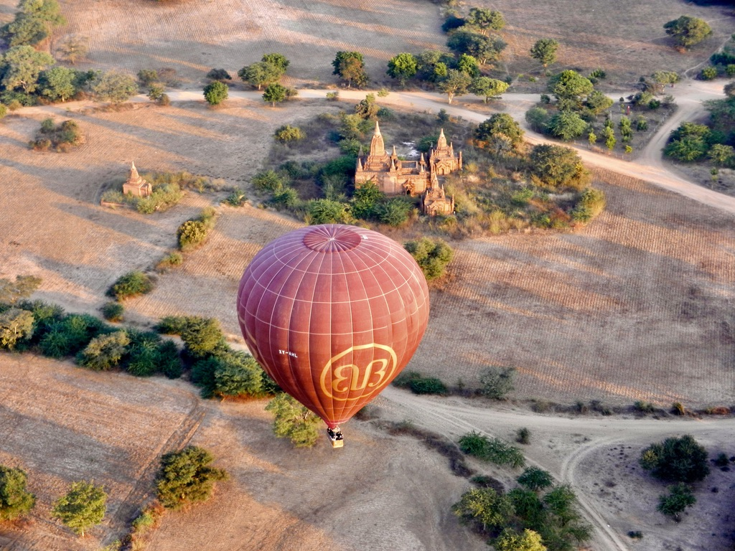

Bagan, Burma

Slide 13
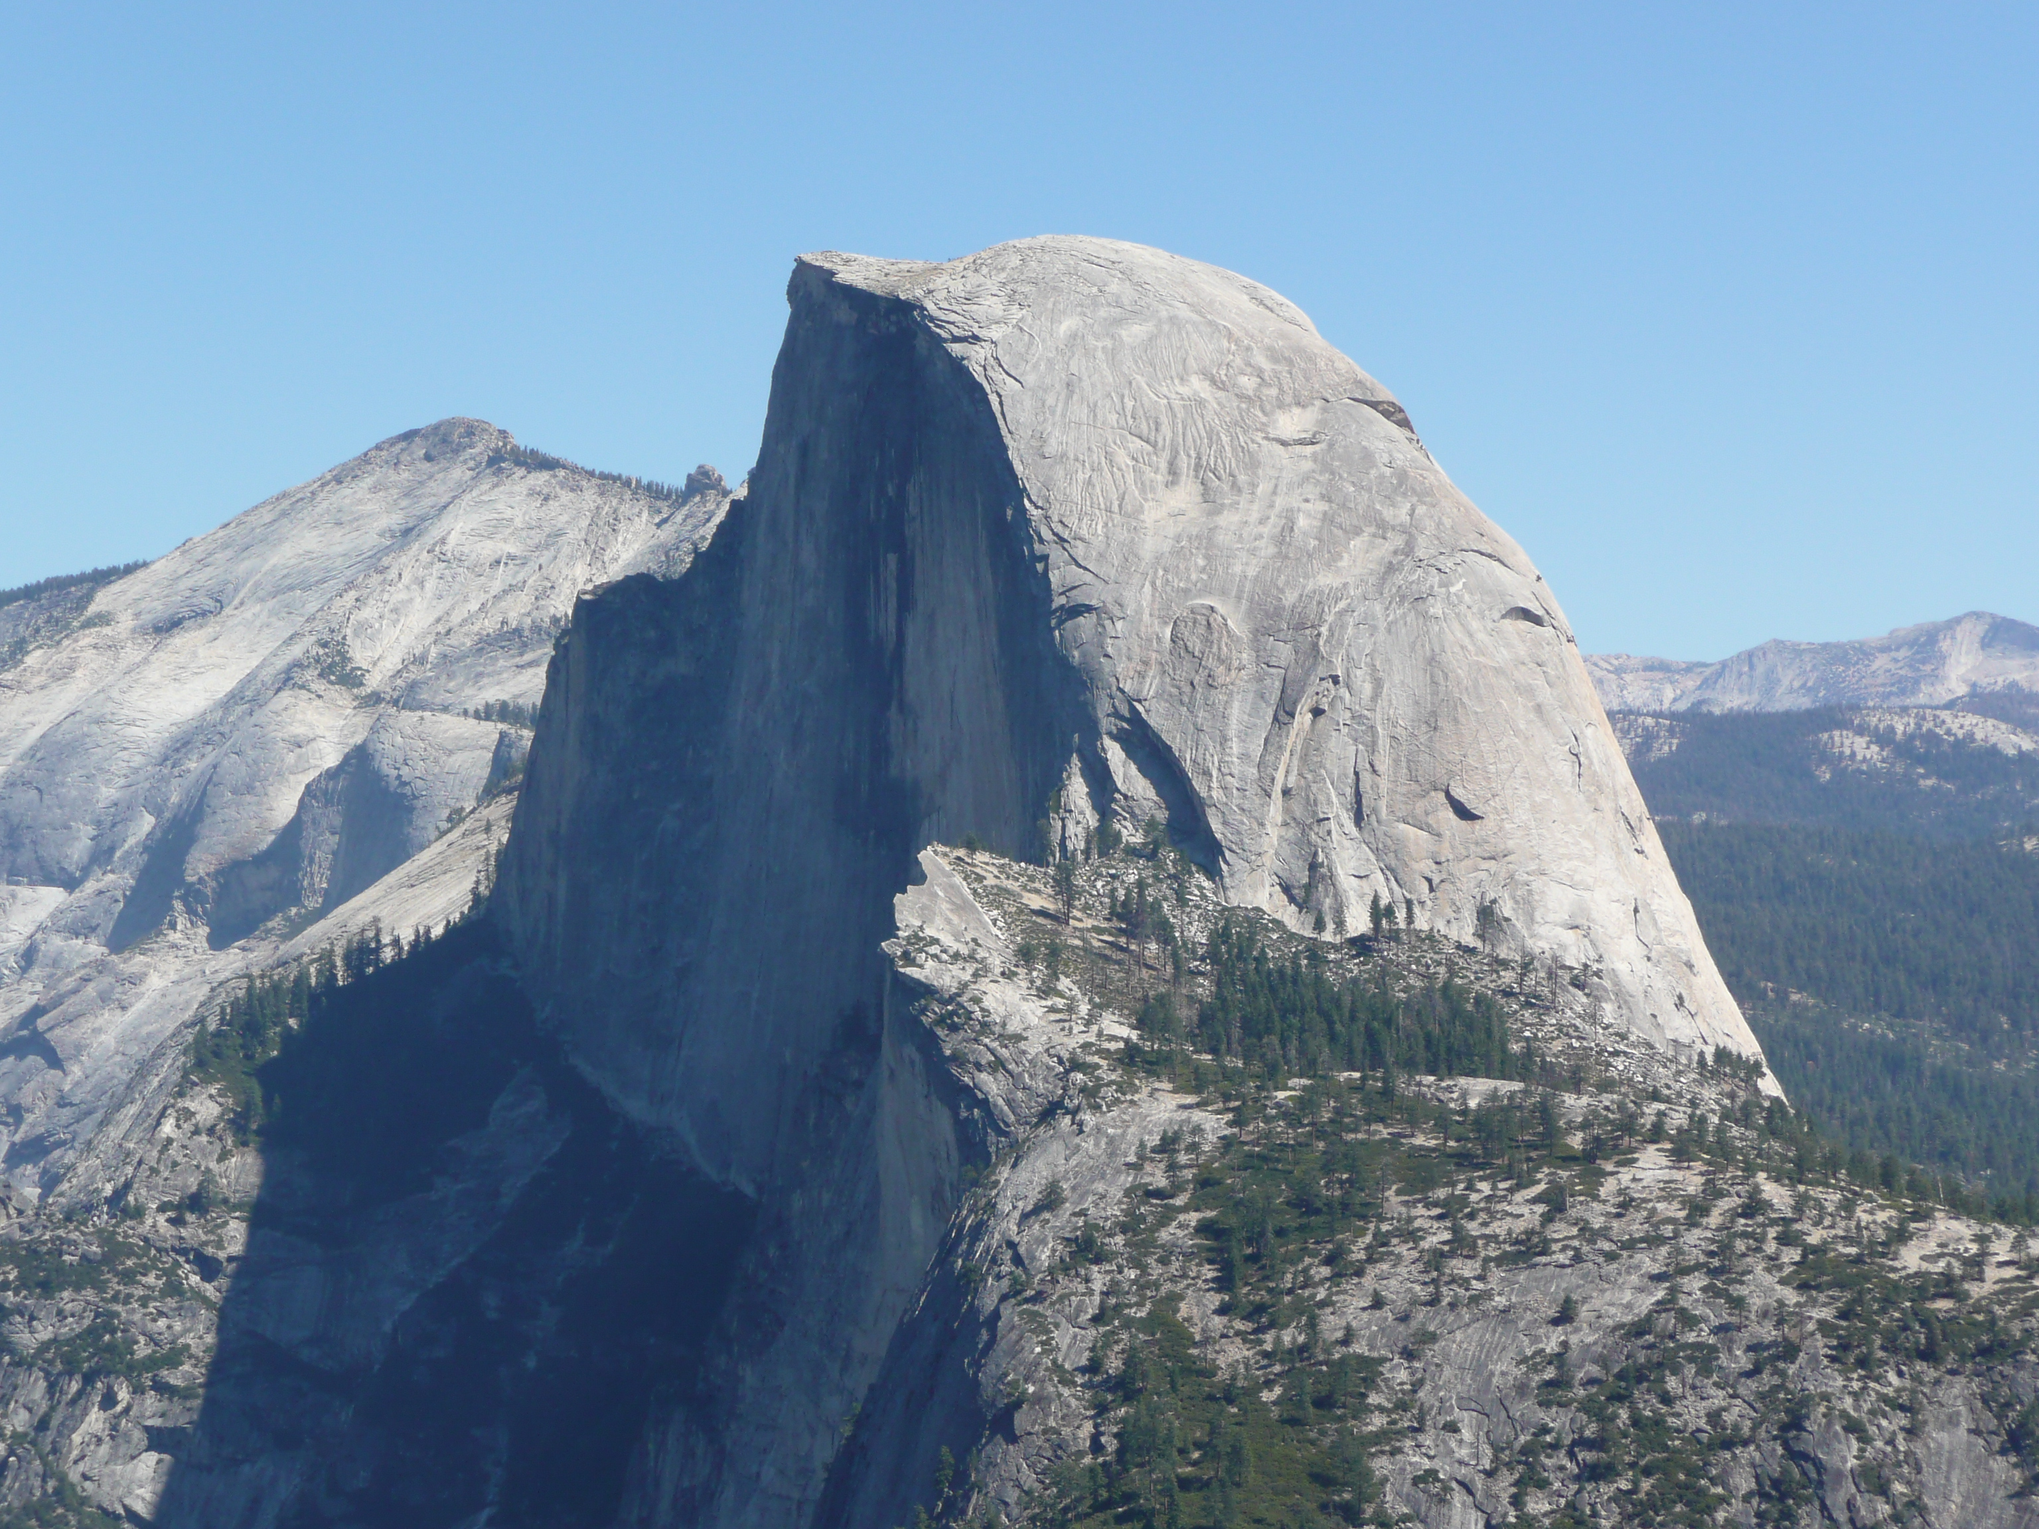
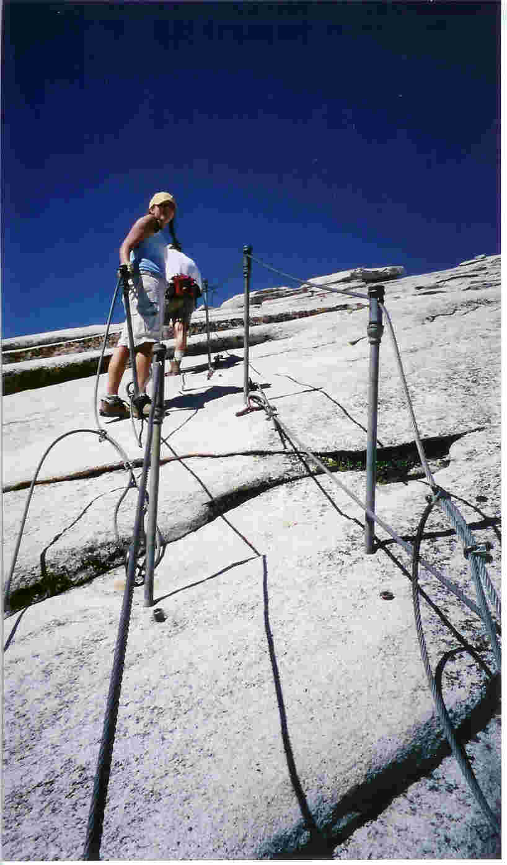
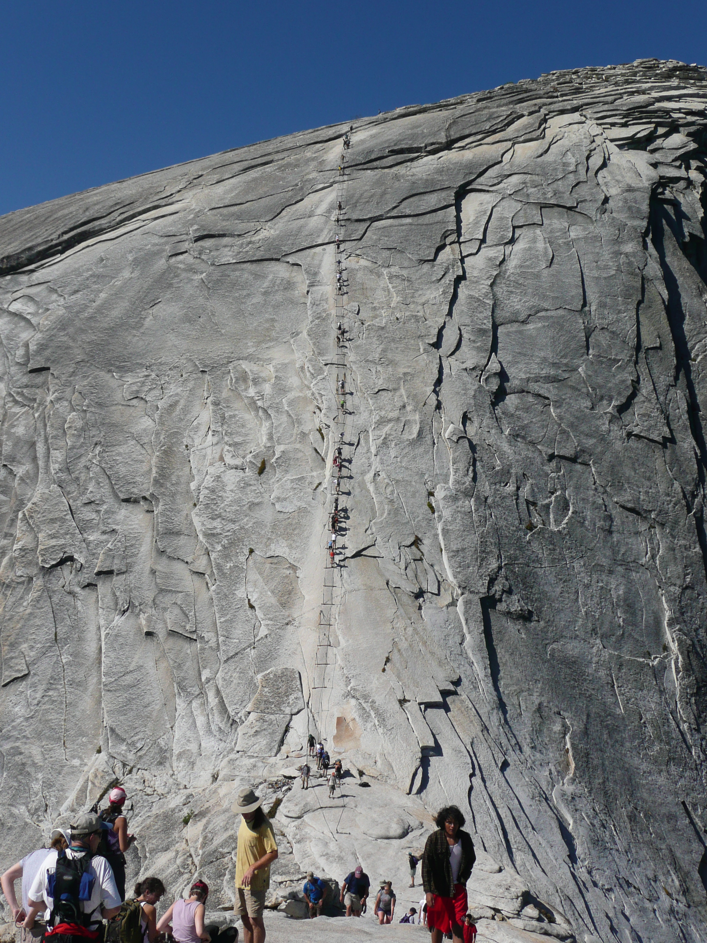
Yosemite
Half Dome
Hike

Slide 14
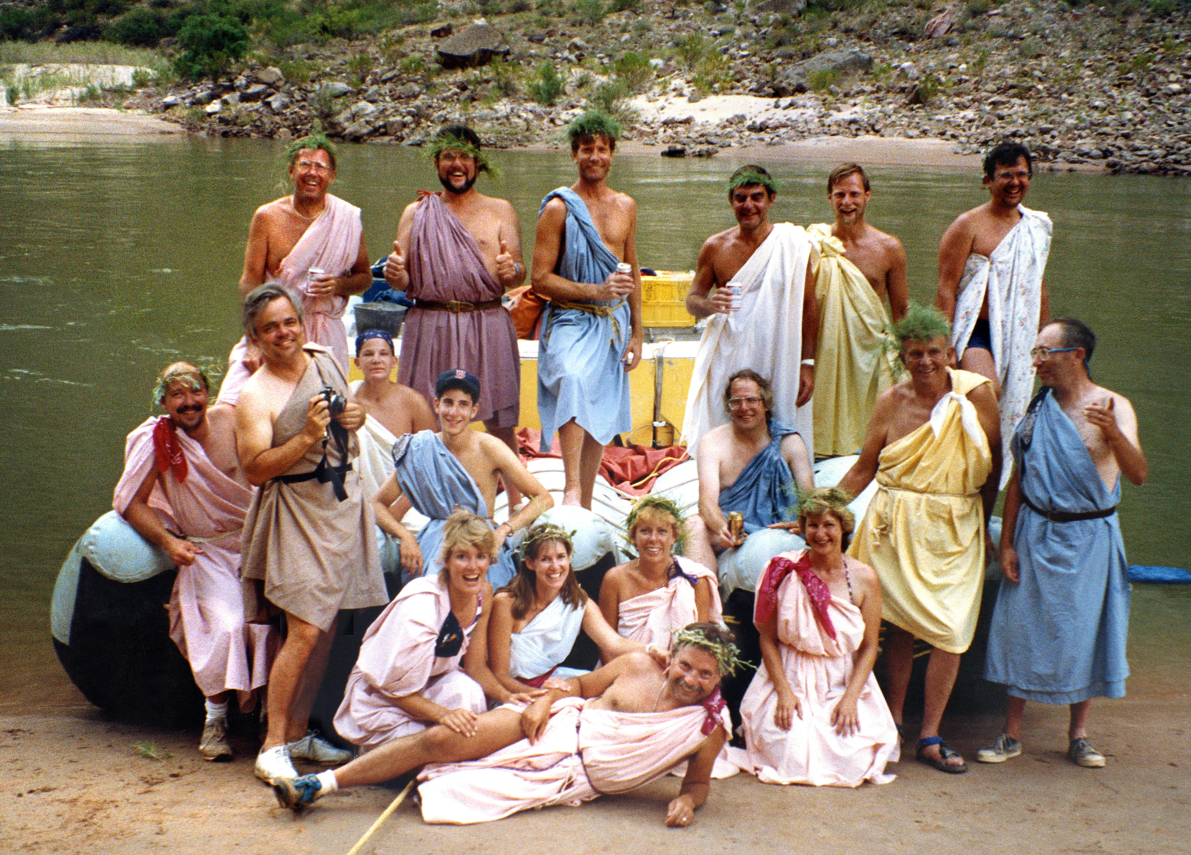
Colorado River Rafting: Toga Party

Slide 15
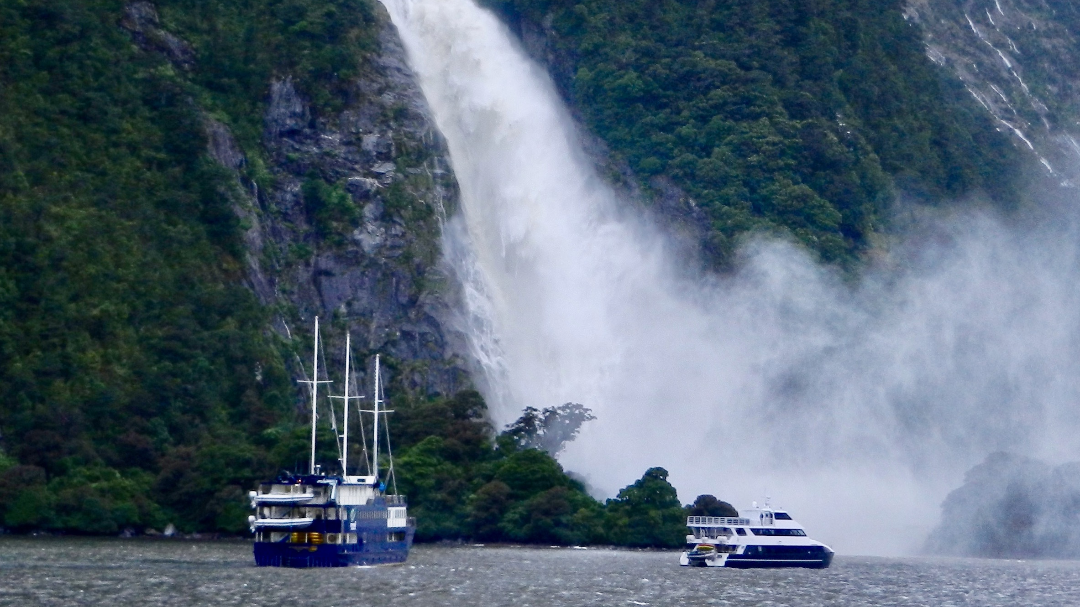
Milford Sound, South Island, New Zealand

Slide 16
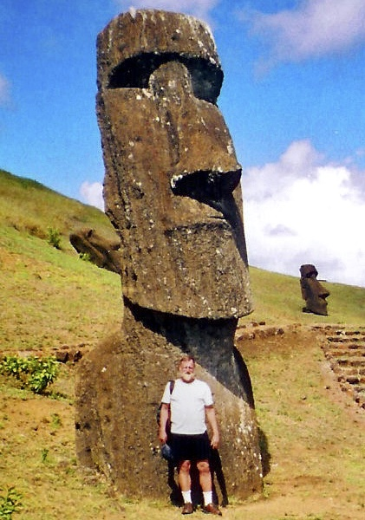
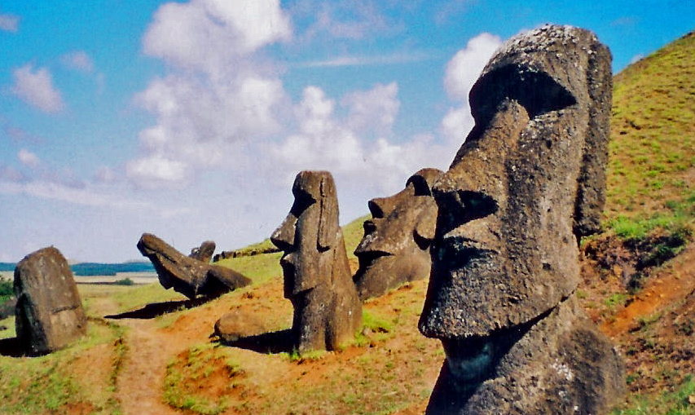
Easter Island
Easter Island

Slide 17
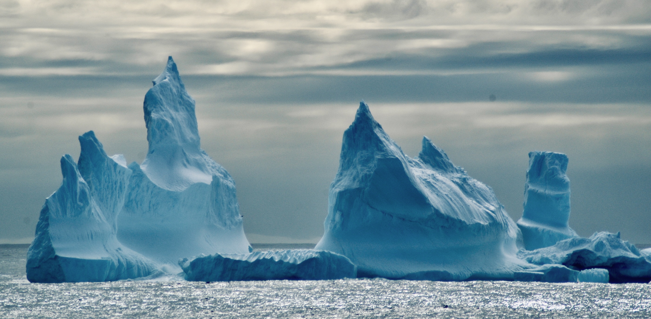
Antarctica

Slide 18
Travel Thoughts To Live By
“The world is a book and those who do not travel read only one page.”
-- Saint Augustine
“We shall not cease from exploring and the end of all our traveling will be to arrive where we started and know the place for the first time.”
-- TS Eliot
“I shall be telling this with a sigh somewhere ages and ages hence: Two roads diverged in a wood, and I – I took the one less traveled by, and that has made all the difference.” -- Robert Frost
“Life is either a great adventure, or nothing at all.” -- Helen Keller
“I get to CREATE who I am, where I want to go and who/what I will be. How fortunate am I? I need to be intentional and do it well.” -- Glenn Detrick

Slide 19
References
My Personal Website: www.gdetrick.org
  Travel Section
  Book Notes
  Education Section
  Chelsea Centers – Nepal and St. Louis
  Email: Glenn.Detrick@gmail.com
  Book Recommendation: “Man’s Search for Meaning” by Viktor Frankl
  Countries and Territories List (330): www.Travelerscenturyclub.org
  (”Travel Dreams Sold Here” by Graydon (Gig) Gwin, at Amazon)
  BE INTENTIONAL

